Slide 1
Lecture 13: Second-Order Systems
Time Response
Lecture 12: First-order systems
Lecture 13: Second-order systems
Lecture 14: Non-canonical systems

Slide 2
Review
We can find the time response of dynamic systems for arbitrary initial conditions and inputs
Classifying the response of some standard systems to standard inputs can provide insight
Ex Systems: first order, second order
Ex Inputs: impulse, step, ramp, sinusoid

Slide 3
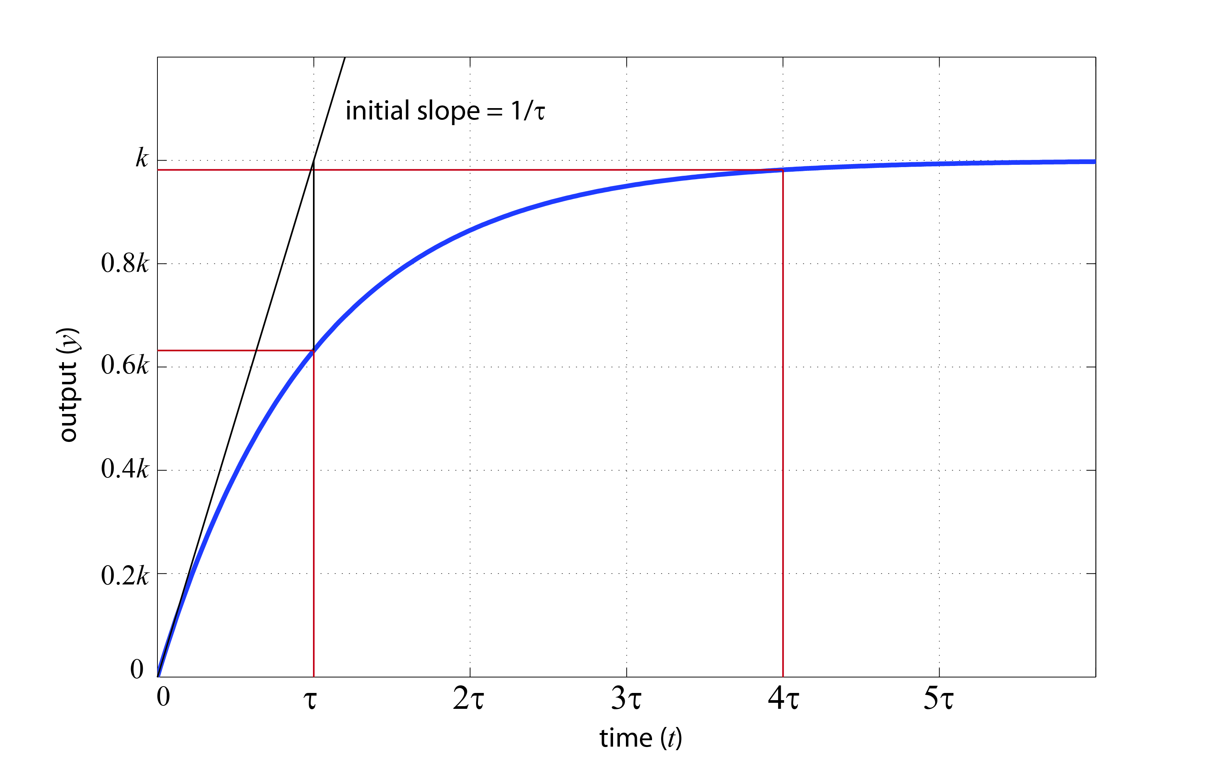
Review
First-Order Systems:
Step Response:

Slide 4
Second-Order Systems
Basic form:
Key parameters:
ω_{n} = (undamped) natural frequency
ζ = damping ratio
σ = real part of pole (rate of decay/growth)
ω_{d} = imag part of pole (damped natural freq)
Notes:
Called second order because second derivative in the differential equation and two poles in the transfer function
Recall what the inverse laplace transform of this is … recall meaning of poles for time response … what was the pole for a first order system
Note unity steady state gain and no zeros
Write on board

Slide 5
Second-Order Systems
Behavior changes fundamentally with ζ
(ζ = 0) poles are imaginary (undamped)
(ζ < 1) poles are complex (underdamped)
(ζ = 1) repeated real pole (critically damped)
(ζ > 1) distinct real poles (overdamped)
Notes:
Write on board

Slide 6
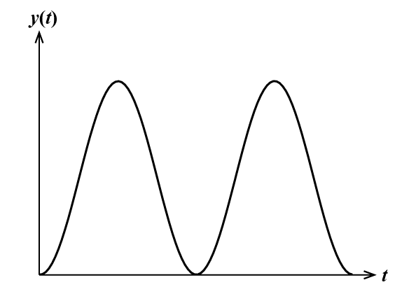
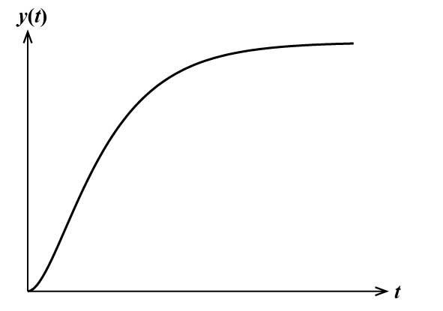
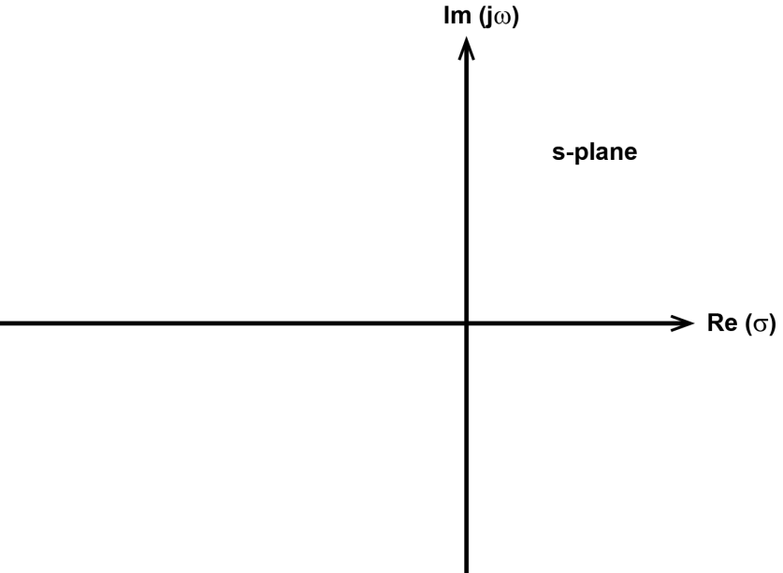
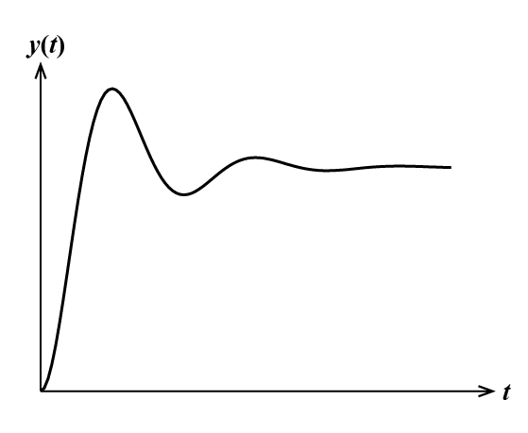
Second-Order Systems
x
x
(ζ = 0) undamped
(ζ = 1) crit damped
x
x
x
x
x
x
(0< ζ < 1) underdamped
(ζ > 1) overdamped

Slide 7
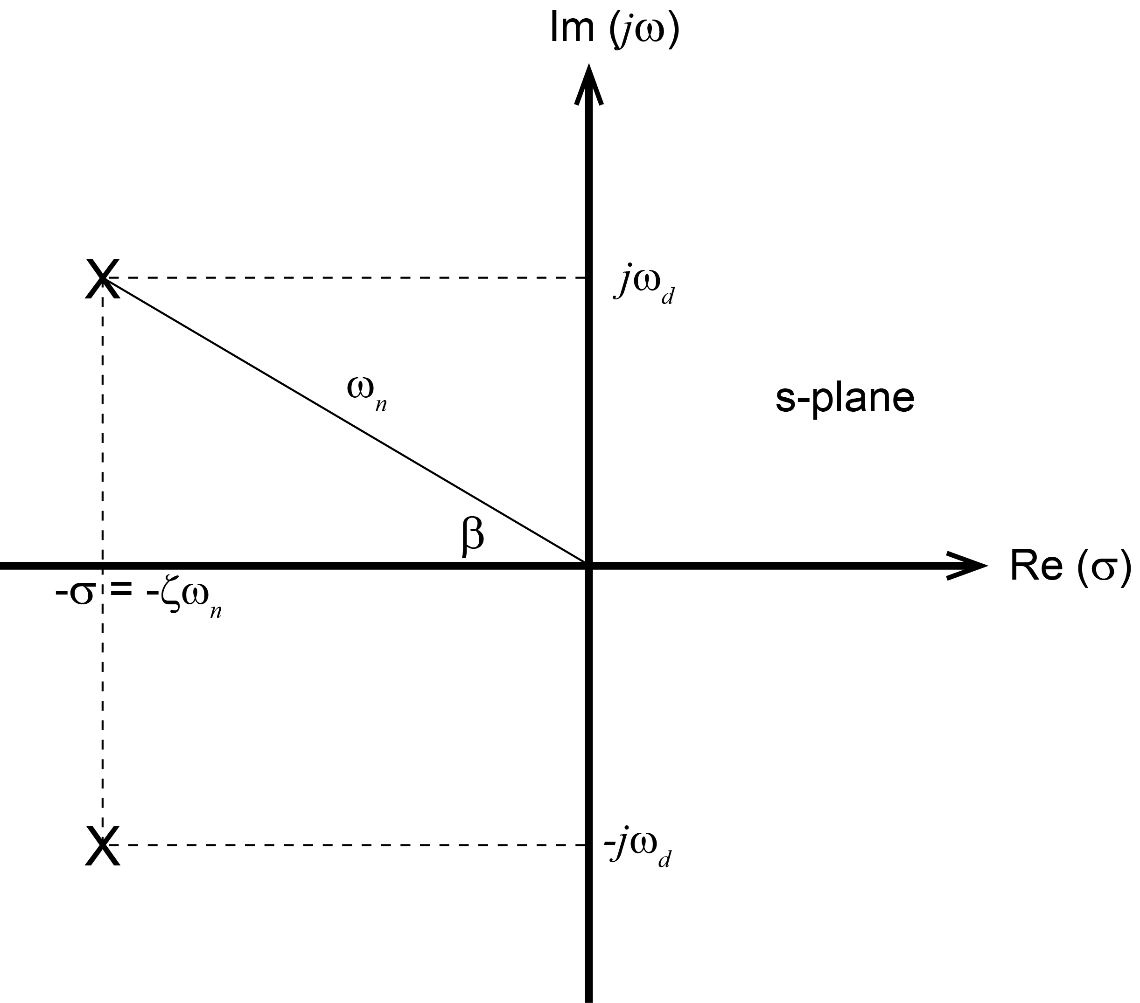
Second-Order Systems
Pole locations determine time response
Notes:
Each of the response characteristics depends on wn, wd, zeta, all of which relate to pole location
Draw on board

Slide 8
Second-Order Systems
Underdamped step response (u(t) = 1(t))

Slide 9
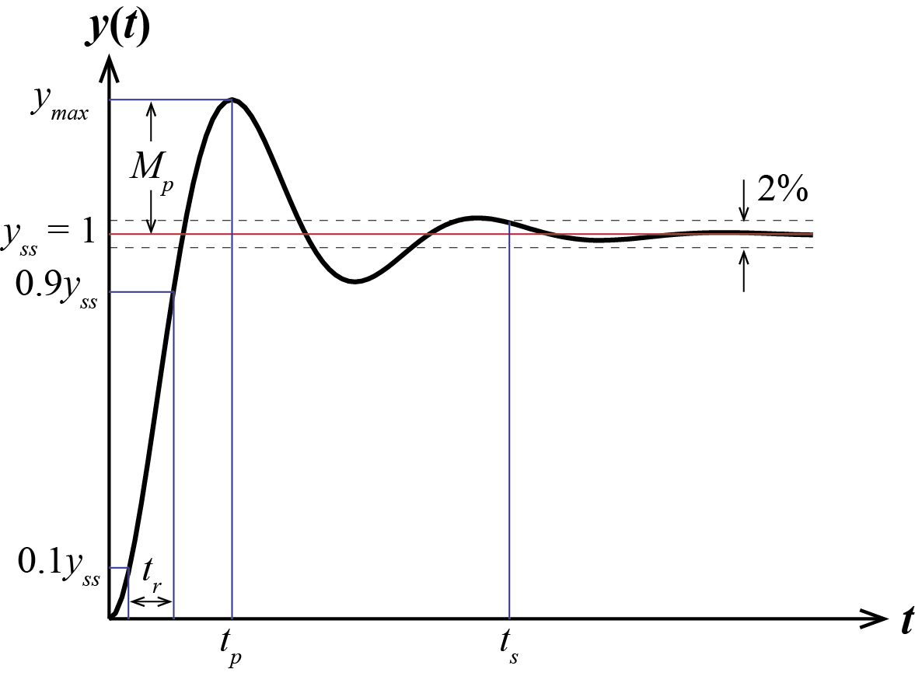
Second-Order Systems
Several important properties for specifying a system come from its step response
Notes:
Replace with Ogata Figure 10-21 … Draw on Board so can refer to?

Slide 10
Second-Order Systems
Delay time: (t_{d}) time required for response to reach half the final value for the first time
Rise time: (t_{r}) time required for response to rise from 10% to 90% (or 0% to 100%)
Wouldn’t want to use 0% to 100% definition for overdamped systems

Slide 11
Second-Order Systems
Settling time: (t_{s}) time required for response to reach and stay within 2% of final value
Approximated from the exponential decay, calculated value is often conservative
since e⁻⁴ ≈ 0.02,

Slide 12
Second-Order Systems
Peak time: (t_{p}) time required for response to reach first peak of the overshoot
for first time when

Slide 13
Second-Order Systems
Maximum overshoot: (M_{p}) maximum peak value measured from ss value (often as %)
Notes:
Only a function of zeta

Slide 14
Second-Order Systems
Summary
2% Settling time
Peak time
Maximum overshoot
(relations only hold for a canonical 2nd-order underdamped step response)
Notes:
Also write Mp as a percentage
Draw on board

Slide 15
Example
Plot the step response of
Notes:
Also point out pole locations?

Slide 16
Example (continued)
Notes:
Also point out pole locations?

Slide 17
Second-Order Systems
Constant property lines
Notes:
Refer back to pole location picture
Discuss with this picture on board before revealing this figure

Slide 18
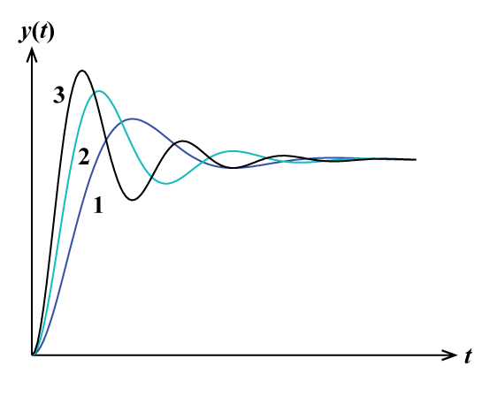
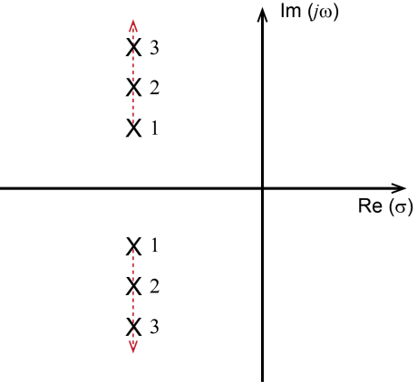
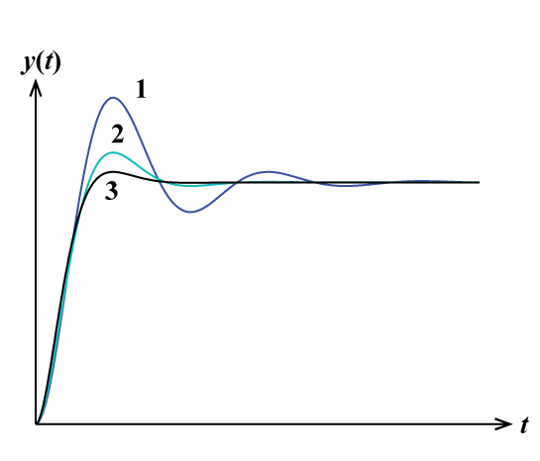
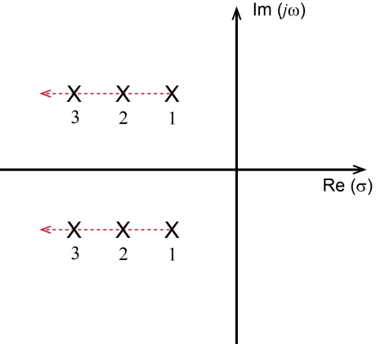
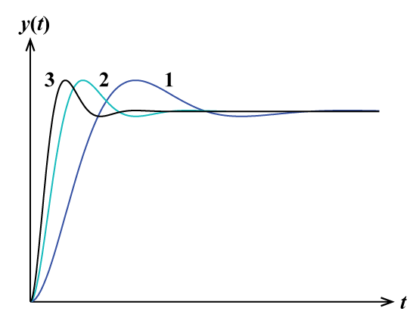
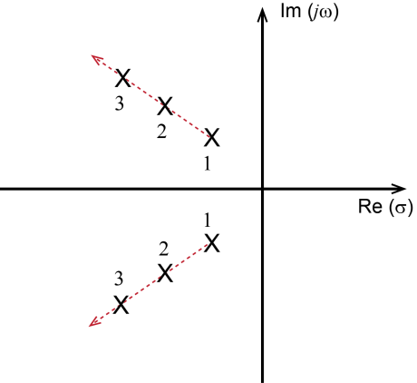
Second-Order Systems
Increasing ω_{d}
(constant σ)
Increasing σ
(constant ω_{d})
Increasing ω_{n}
(constant ζ)

Slide 19
Second-Order Systems
Overdamped step response (u(t) = 1(t))
Notes:
Looks like a first order sytem, but with zero initial derivative

Slide 20
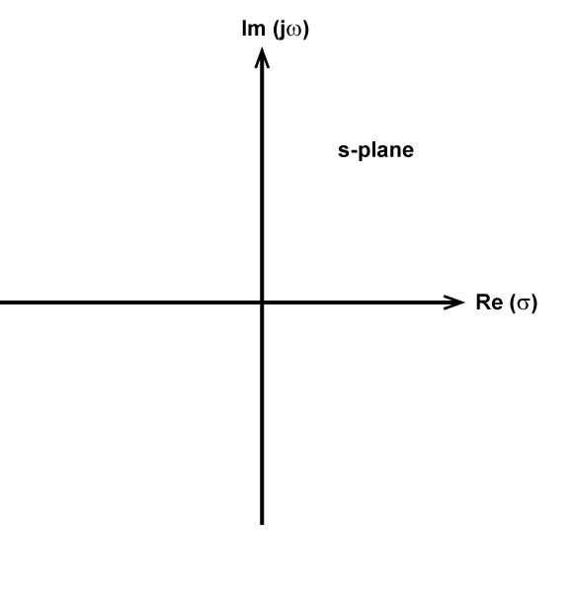
Second-Order Systems
x
x
(ζ = 0) undamped
(ζ = 1) crit damped
x
x
x
x
x
x
(0< ζ < 0) underdamped
(ζ > 1) overdamped

